Slide 1
Azure Site Recovery Overview
PRESENTER NAME
(Updated 6/2023)

Slide 2
Azure Site Recovery
Azure Site Recovery Use Cases
General Terminology
Azure Primitives Review
Azure Site Recovery General Overview
Azure Site Recovery Azure-to-Azure Overview
Azure Site Recovery VMWare-to-Azure Overview
Design Considerations and Recommendations

Slide 3
Azure Site Recovery Use Cases
Replicate Azure VMs from one region to another
Replicate Azure VMs between availability zones
Migrate Azure VMs not within an availability zone to an availability zone
Migrate Azure VMs from one subscription to another
Replicate on-premises VMWare VMs to Azure
Replicate on-premises Hyper-V VMs to Azure
Replicate on-premises physical services to Azure
Replicate on-premises VMWare VMs, Hyper-V VMs, and physical servers between customer data centers
Notes:
Replication non-zonal to zonal can only be done through CLI
Replication of a VM in one AZ in regionA can be replicated to a different AZ in regionA in a limited set of locations (https://learn.microsoft.com/en-us/azure/site-recovery/azure-to-azure-how-to-enable-zone-to-zone-disaster-recovery)
You cannot replicate a non-zonal VM within the same region (https://learn.microsoft.com/en-us/azure/site-recovery/azure-to-azure-common-questions#can-i-replicate-non-zoned-virtual-machines-within-a-region)

Slide 4
General Terminology
Business Continuity
How an organization maintains critical business operations during and after a disaster
Disaster Recovery
Component of business continuity that is focused on restoration of critical IT applications and data after a catastrophe
Backup
Process of making a copy of data in order to protect it against accidental or malicious deletion or corruption
High Availability
Process of eliminating single points of failure to ensure components are continuously available
Recovery Time Objective (RTO)
Maximum length of time it should take to restore normal operations following an outage
Recovery Point Objective (RPO)
Maximum amount of data the organization can tolerate losing

Slide 5
Azure Primitives
Geography (AKA geopolitical region)
Collection of one or more regions that are grouped for the purposes of specific data residency and compliance requirements
Region
Collection of datacenters within a latency-defined perimeter
Paired Regions
Set of Azure regions that provide out-of-the-box cross-region replication or recovery capabilities for services like Azure Storage, Azure Key Vault, and others
No SLA provided for cross-region replication
Availability Zone
Physically separate locations that are fault tolerant to local failures
Round-trip latency of less than 2ms
Composed of one or more datacenters equipped with independent power, cooling, and networking
Not available in all regions

Slide 6
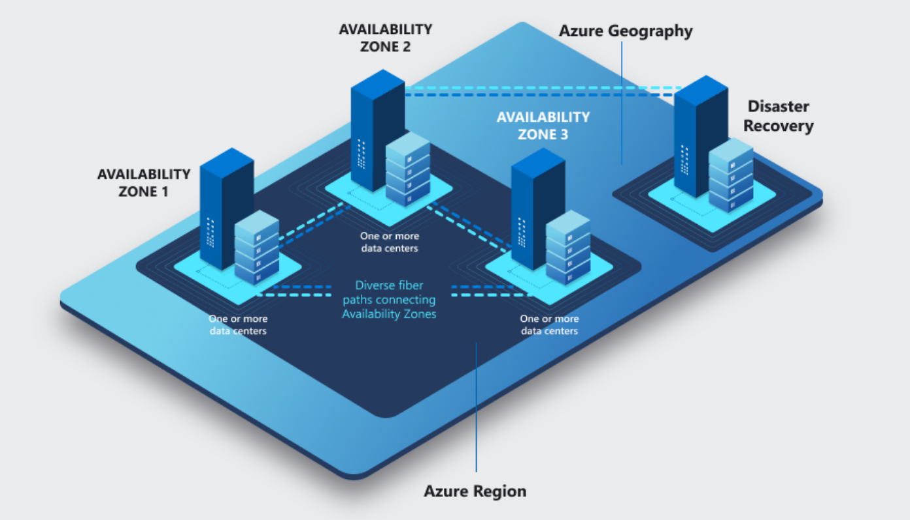
Azure Primitives

Slide 7
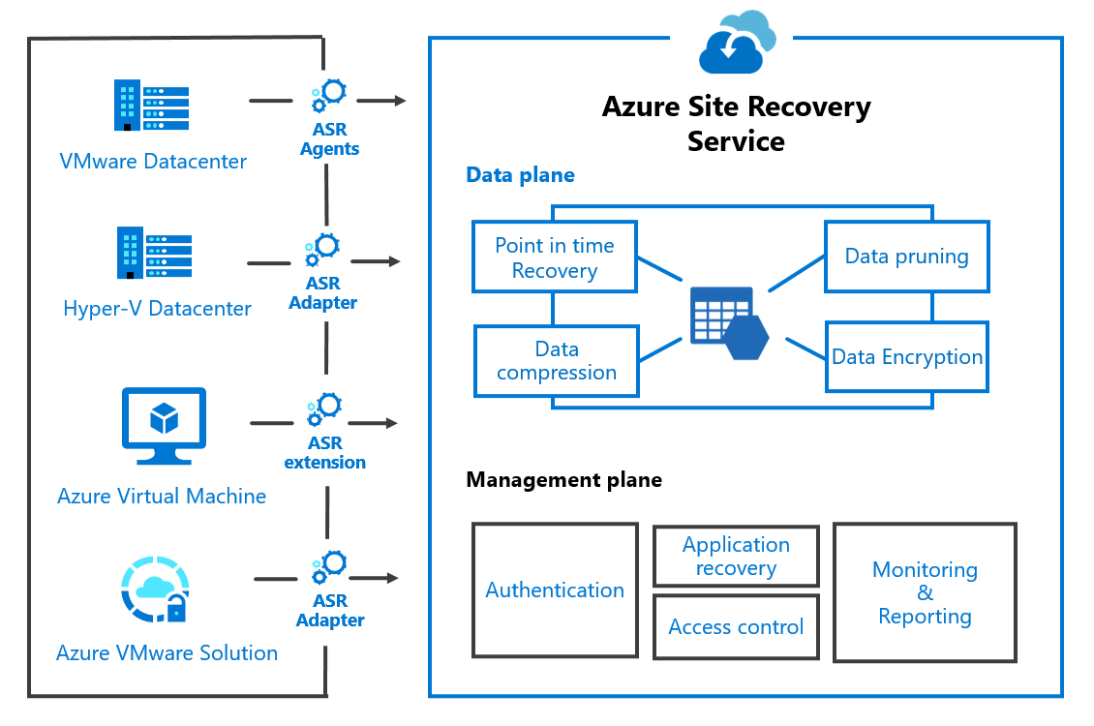
Azure Site Recovery - Architecture

Slide 8
Azure Site Recovery – Service Terminology
Recovery Services Vault
Regional Azure resource used to hold recovery plans, replication policies, and metadata about resources being replicated
Recovery Points
A point in time capture of a machine that can be used to recover the machine
App-consistent and crash-consistent snapshots
Retain up to 15 days
Replication Policy
Assigned to replicated machines/groups
Configure retention (in days) for snapshots
Configure app-consistent snapshots are taken and how frequently
Network Mappings
Maps the source network to the destination network a replicated machine will be placed in
Cache Storage Account
Azure Storage Account that stores machine changes before being sent to managed disks or unmanaged disk

Slide 9
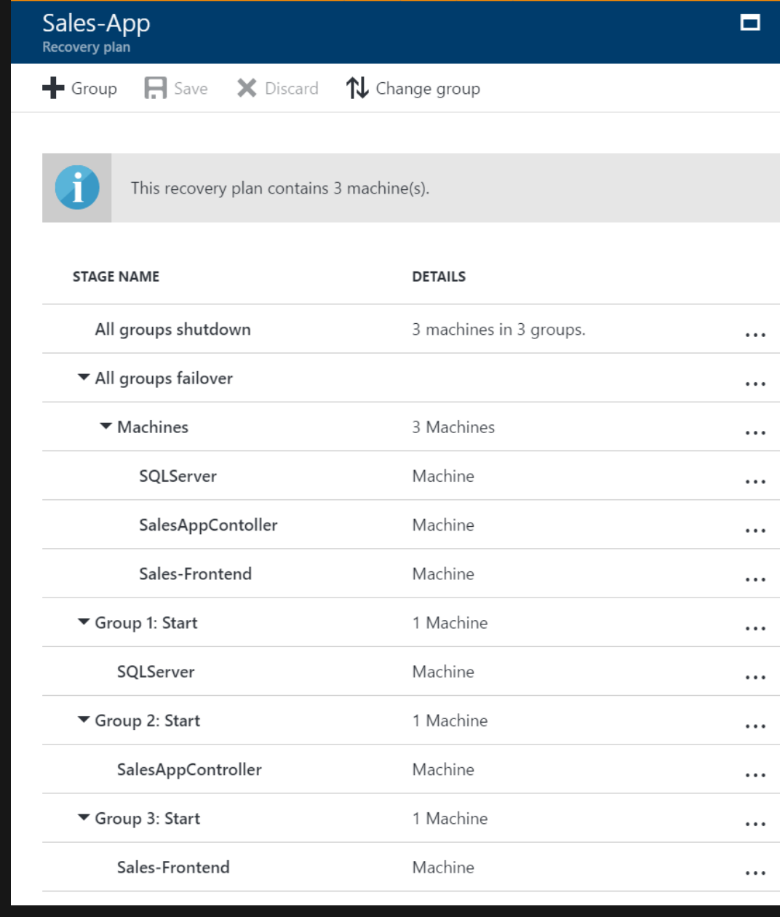
Azure Site Recovery – Service Terminology
Recovery Plan
Orchestration of multi-step recovery process for one or more VMs
Group VMs and failover in a user-specified order
Include automated and manual tasks pre and post steps
Notes:
Automated tasks are performed using Azure Automation
Up to 100 instances per recovery plan

Slide 10
Azure Site Recovery – Key Features
Reliability
Ease of use
Performance
Crash Consistency
Application Consistency
No-impact DR drill
Recovery points up to 15 days
Point and click Graphical UI
Centralized monitoring and alerting
Automation support
Auto upgrade of ASR agents
RPO of minutes
SLA-backed RTO
Continuous replication
Compression
Notes:
No-impact DR drill with test failover functionality
SLA backed RTO - https://azure.microsoft.com/en-us/support/legal/sla/site-recovery/v1_2/

Slide 11
Azure Site Recovery – Consistency Options
Application Consistent
Captures memory content and pending writes are captures as part of the backup (think databases)
Application is informed a backup is occurring so changes in memory are written to disk
Windows – Volume Shadow Copy Service (VSS) and Linux – Customer scripted
Optional and can be taken every 1 hour (with 1 day retention) and every 2 hours with <1 day retention and retained one per hour or two hours for up to 15 days
Crash-Consistent
Snapshot taken of all files at the same time (think of a system being suddenly powered off)
Application data still in memory is not captured
Taken every 5 minutes and retained for up to 15 days*
Multi-VM Consistency
Site Recovery orchestrates a group of machines to ensure crash-consistent and app-consistent recovery points are created at the same time
Machines require a communication channel between each other
CPU intensive and can affect performance of machine so only enable where necessary
Notes:
If app-consistent snapshots are taken as well, then crash consistent snapshots are completely pruned after >2 hours and only application consistent is maintained
Frequency of crash-consistent snapshots cannot be changed

Slide 12
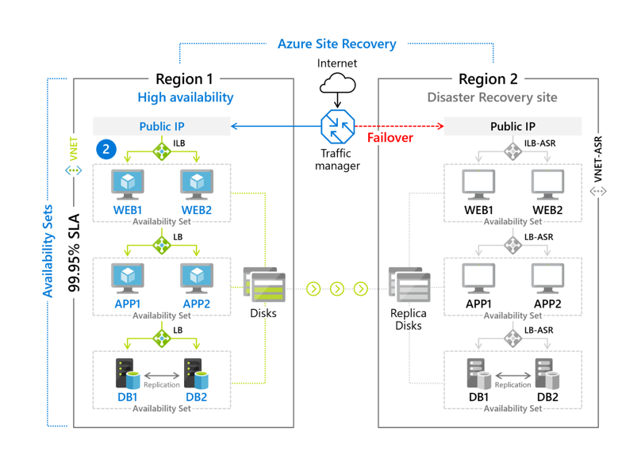
Azure Site Recovery – Pricing
Storage cost
Compute Cost
Managed Disks
No compute costs at steady state of operations
Pay for compute only at failover
ASR Licensing
Pricing benefits
Network cost
$25 per VM/month
Software Assurance
Hybrid Benefit
~ 50% (after compression) of data churn on the disks
Notes:
First 31 days are free ($25/vm/month)

Slide 13
Azure Site Recovery - Security
Encryption-in-transit and encryption-at-rest
Communication channels support TLS
Support for VMs encrypted with Managed Disk encrypted with SSE-CMK (server-side encryption with customer managed key) and machines encrypted with ADE (Azure Disk Encryption)
Vaults are encrypted with PMK and can optionally be encrypted with CMK
Network Security
Support for Private Endpoints
Support for ExpressRoute connectivity using Private Peering and Private Endpoints
IAM
Secured via AAD (Azure Active Directory) authentication and Azure RBAC roles
Support for user-assigned and system-assigned managed identity of the vault
Notes:
Vault is configured with Private Endpoint and cache storage account is configured with Private Endpoint
Note there are some flows for connectivity over ExpressRoute (such as Azure AD) which will egress the machine’s standard Internet path

Slide 14
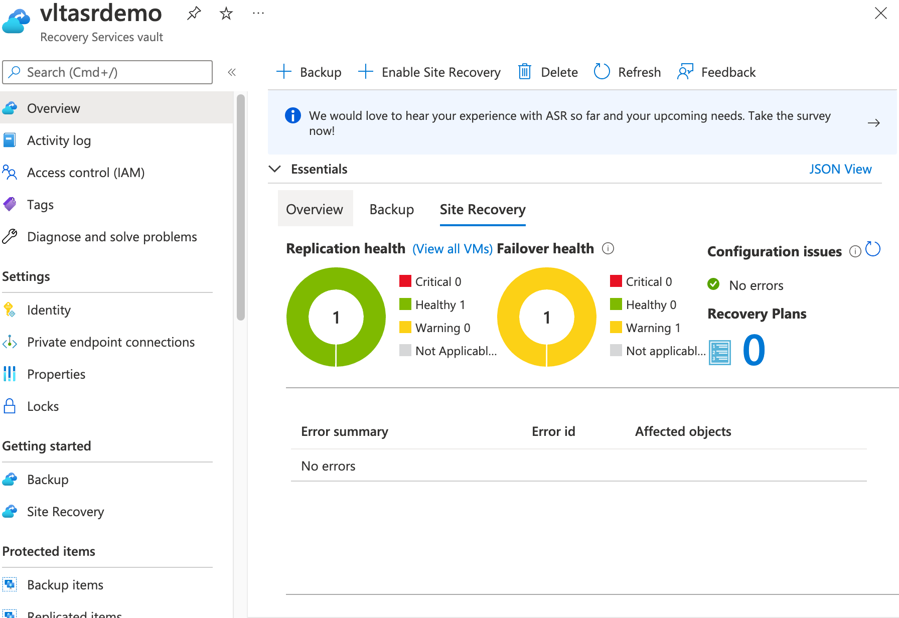
Azure Site Recovery – Automation, Monitoring, Alerting
Automation
Integration with Azure Automation for automation of activities after failover
Interact through Portal, PowerShell, CLI
IaC such as Terraform, Bicep, and ARM
Monitoring and Alerting
Dashboards available through Recovery Services Vault
Integration with Azure Monitor to produce logs and metrics which can be stored in a Log Analytics Workspace for analysis and retention
Integration with Azure Alerting
Notes:
Azure Automation works great for management-plane operations but not so much data-plane operations

Slide 15
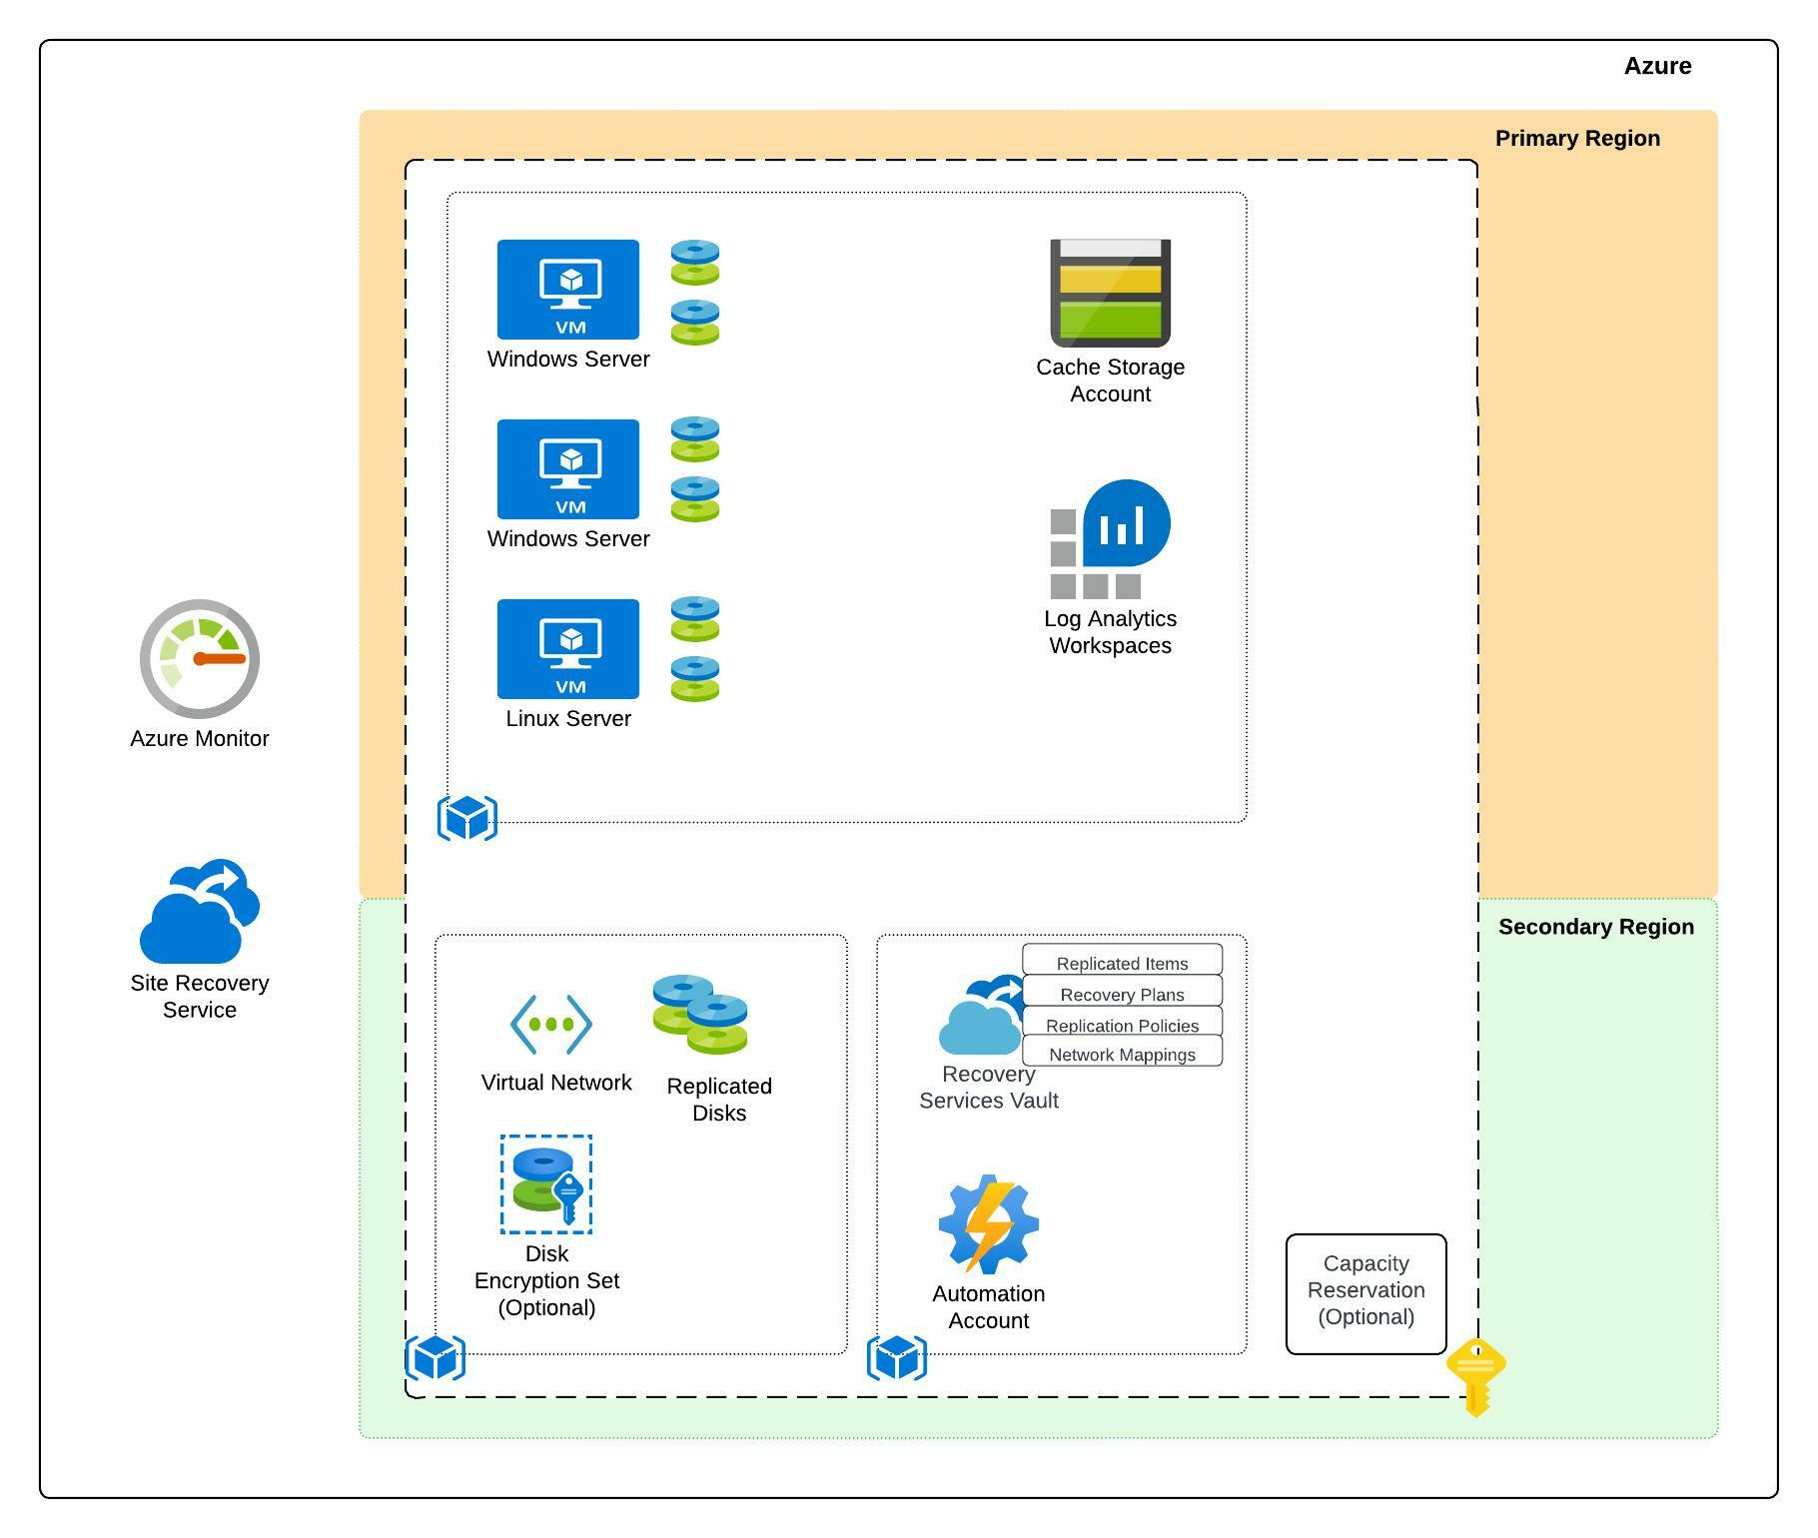
Azure Site Recovery Azure-to-Azure Architecture
Notes:
Log Analytics Workspace used to store signals generated from Site Recovery’s integration with Azure Monitor
Pre-configure Disk Encryption Set, Virtual Network, Azure Automation account

Slide 16
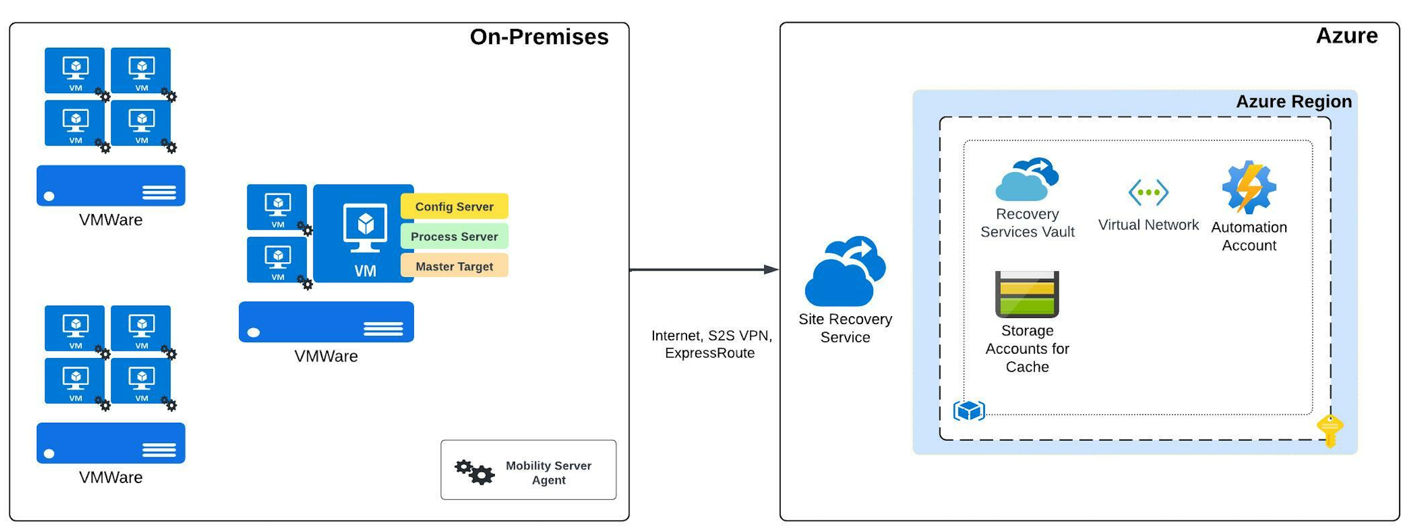
Azure Site Recovery VMWare-to-Azure Architecture

Slide 17
Azure Site Recovery VMWare-to-Azure Replication Components
Config Server*
Centralized management component
Process Server*
Replication gateway component that receives replication data, optimizes it for caching, compression, encryption, and sends to Azure
Installs mobility service on servers
Scaled depending on replication traffic
Master Target Server*
Used for failback only when failing back from Azure
Scalable in very large environments
Mobility Server Agent*
Captures data, writes on the machine, and sends to process service
Notes:
Recovery Replication components support stand-alone deployment and deployment via OVA (Modern experience)
VMWare vCenter or ESXi permissions are required for replication components (https://docs.microsoft.com/en-us/azure/site-recovery/vmware-azure-tutorial-prepare-on-premises#vmware-account-permissions)
Mobility Server Agent supports manual, automated (configuration manage), and push installation

Slide 18
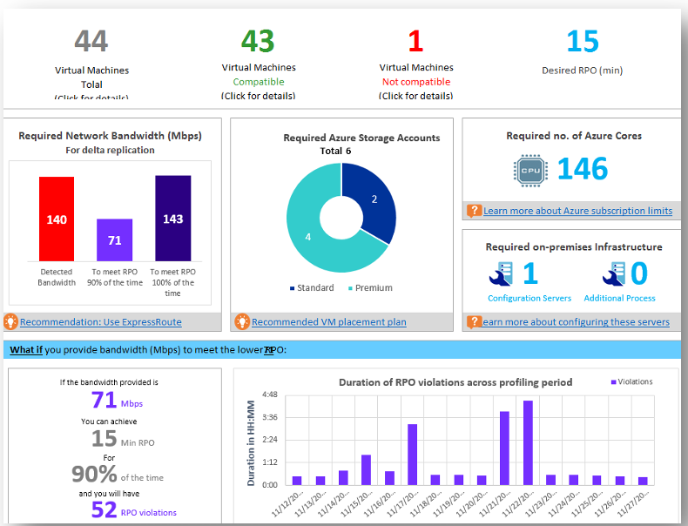
Azure Site Recovery - Deployment Planner
Used for VMWare to Azure and Hyper V to Azure replication planning
Provides capability assessments, network bandwidth and RPO assessment, azure infrastructure requirements, on-premises infrastructure requirements, and estimated disaster recovery costs for Azure
Run in multiple stages including profiling and report generation
No effect on VMs because it communicates directly with VMWare vCenter or ESXi hosts
Notes:
Compatibility assessment
VM eligibility (disks, IOPS, churn, OS version)
Network bandwidth and RPO assessment
Bandwidth required for replication, number of VMs to batch, RPO that can be achieved given bandwidth, impact on desired RPO if lower bandwidth is provisioned
Azure infra requirements
Storage type (std/prm), number of azure cores for test failover, recommended VM size)
On-premises infra requirements
Required number of config servers and process servers
Estimated disaster recovery cost for Azure
Estimated disaster recovery (broken down by VM)

Slide 19
Azure Site Recovery – Design Considerations and Recommendations
Know whether you require an application-consistent backup or crash-consistent recovery points
Evaluate the solution to ensure it aligns with your RPO/RTO
Recovery Services Vault must be created in the destination region you wish to replicate the machines to (unless doing zonal replication)
This is a DR solution, not a high availability solution, if you need high availability use a hot-hot/active-active configuration
When using private endpoints be aware that some traffic (such as Azure AD) will continue to flow over the Internet egress path
Pre-create core infrastructure components such as virtual network, disk encryption sets, Key Vault, and load balancers
Azure Site Recovery makes best effort to ensure capacity is available so use capacity reservations if best effort isn’t enough

Slide 20
Azure Site Recovery – Design Considerations and Recommendations
Use the Test Failover feature to validate your failover will work when you need it
Use Recovery Service plans for all deployments even if it’s a single VM
Ensure your subscriptions have the relevant resources available in the destination region
For VMWare to Azure deployments, use the deployment planner to understand storage and network requirements
Using Azure Automation for management-plane (interact with Azure) activities and be aware using it for data-plane (interact with VM OS) activities can be challenging
Ensure you understand the data churn of your machine
Notes:
Unlike Azure Backup, the Recovery Services Vault can exist in a different subscription from the virtual machines it is protecting
As of 6/1/2023 100MB/s churn for a VM is in public preview in a limited set of regions. Until this goes GA, ASR supports up to 54MB/s. Churn can be monitored using counters similar to https://learn.microsoft.com/en-us/azure/site-recovery/monitoring-high-churn

Slide 21
Appendix – Useful Links
Azure Recovery Services Best Practices and Guidance - https://docs.microsoft.com/en-us/azure/cloud-adoption-framework/manage/azure-management-guide/protect-recover?tabs=AzureBackup%2Csiterecovery
Azure CAF BCDR - https://docs.microsoft.com/en-us/azure/cloud-adoption-framework/ready/landing-zone/design-area/management-business-continuity-disaster-recovery
VMWare-to-Azure Prerequisites - https://docs.microsoft.com/en-us/azure/site-recovery/vmware-azure-tutorial-prepare-on-premises
Azure Site Recovery Lab and Learning Artifacts - https://github.com/mattfeltonma/azure-site-recovery-demo

